Slide 1




Emergency- Help Services
Presented by:
N Krishna Chowdary Pathuri
Lakshmi Pujitha Popuri
Raghavendra Gupta
M. Kedarnath
Guided by:
Vishruti Prajapathi

Slide 2


Use Case
User can utilizes the two types of Emergency services, Provided by the Service Providers.
There are two Services
Medical Services
Fire Services
XYZ is an Organization ,it Connects the both Service providers and clients.
XYZ Organization monitor the perfomace of the service providers

Slide 3
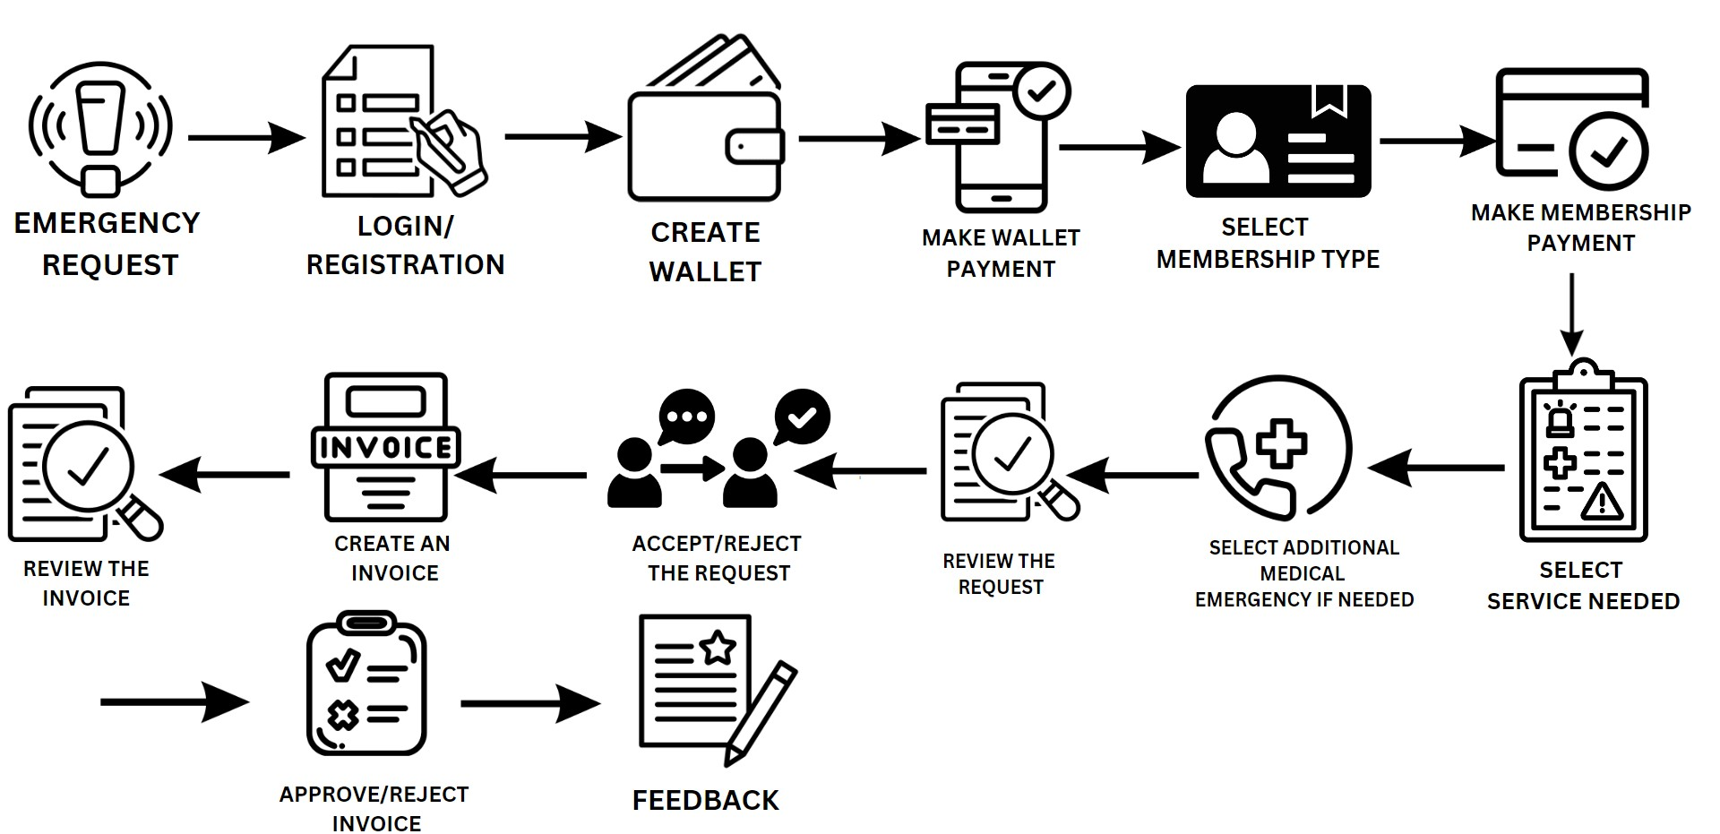
Flow

Slide 4



Personas
Directors
Service Providers
Customer

Slide 5


Concepts Covered
1.Case Management
2.Data Validations
3.Correspondence
4.Attach Documents
5. Field Values
6.Approval and Rejections
7.Declarative Rules
8.Service Level Agreements
9. Visibility
10. Required fields
11. UI-Controls
12. Automation Shapes
13. Savable Data Pages
14. Declare Expressions
15. Reports
16. Portal and Dashboards
17. Routing

Slide 6

Rules Created
•Section
•SLA
•Property
•Flow Rules
•Data Pages
•Integration-Resources
•Decision Rules
•Validations
Edit Validate Rule
Validate Rule

